Slide 1
1st Iteration
Client:
Andres Almaraz and David Luis Hiraldo-Panchana

Slide 2
Goals
This will allow us to see areas in need of retesting in the near future. This will be done by looking at water systems that did not have PFAS but appears similar to water systems that did
Then to see if any factories are part of the cause or source of the issue in traces of PFAS/Teflon in the water
Finding characteristics in the water that had PFAS/Teflon

Slide 3
Roles
 | Major | Minor | Management Role
Andres Almaraz | Data analyzer | Visualization | Project Scribe/Documenter
David luis Hiraldo-Panchana | Data modeler | Visualization | Team manager & Client liaison

Slide 4
Team Plan
https://time.graphics/line/618637

Slide 5





Technologies

Slide 6
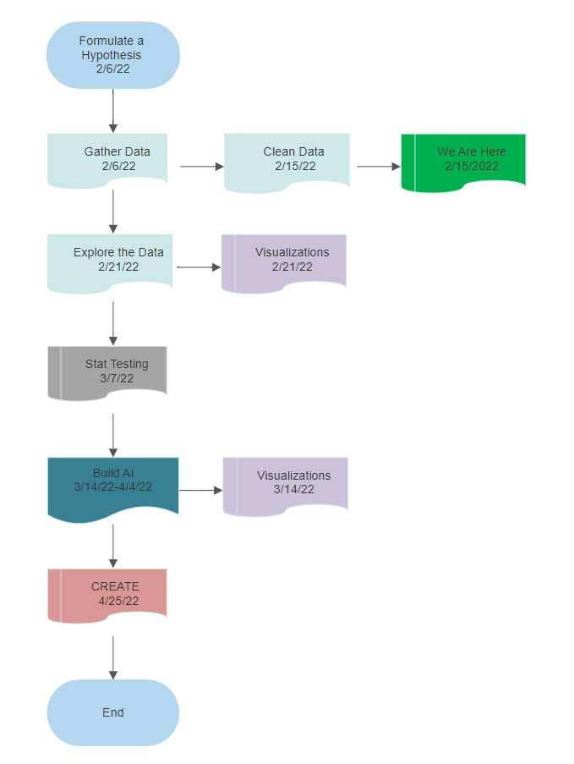
Flow chart of the project
This is our Flow chart of the project, Firstly we need to formulate our Hypothesis, Then gather our data and clean our data. Then we will explore the data further and then add the visualizations. Then we will proceed to push our data through some statistical testing. Then we will use the rest of our time to collaborate with our client and build an AI to try and predict certain patterns and build visualizations along with it. Finally we will present at CREATE.

Slide 7
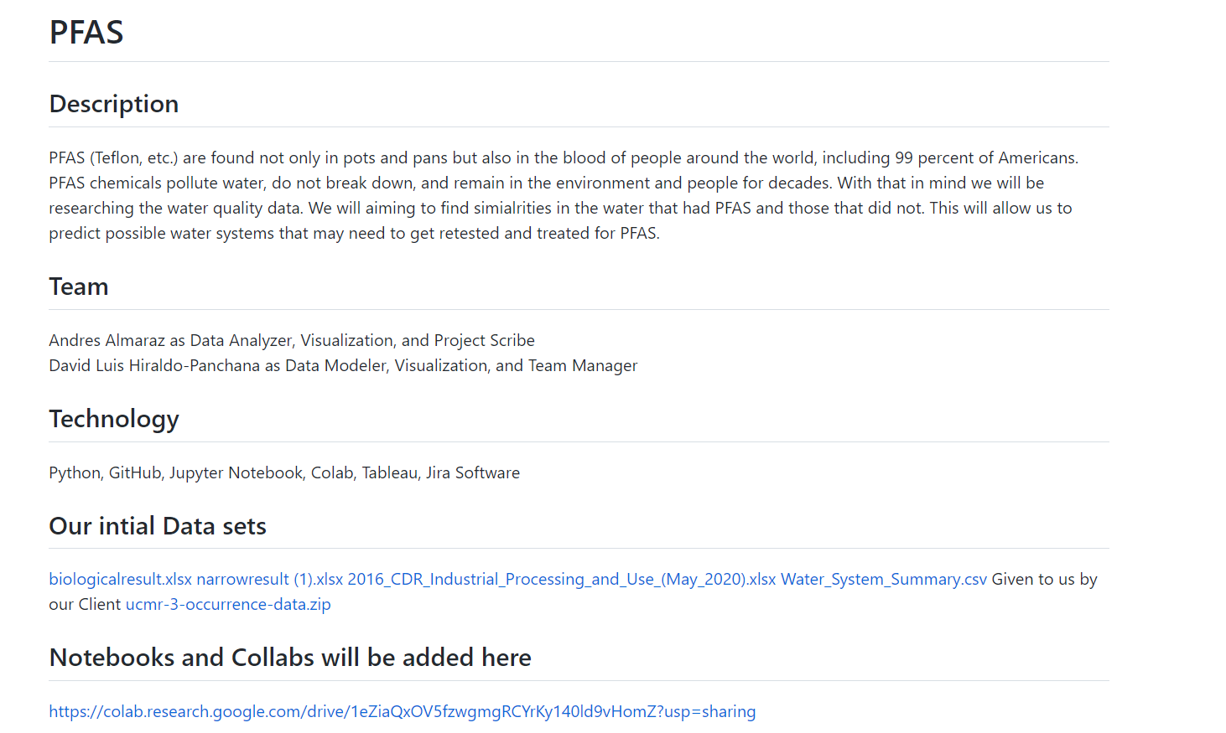
Collections
Read Me
Github is where we store all of our data, so this is where we will update our findings when working with notebook, then we can put together all of our finished findings in our collab, we also need to use github to pull our resources with tableau and our visualizations we have made.

Slide 8
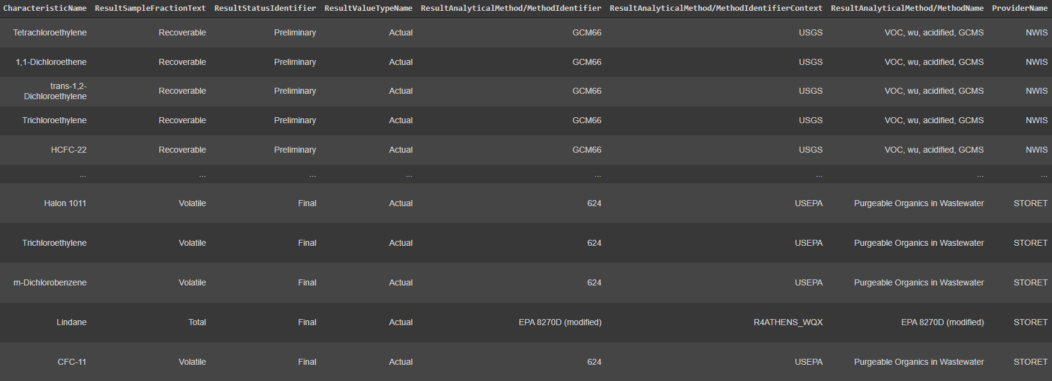

Slide 9
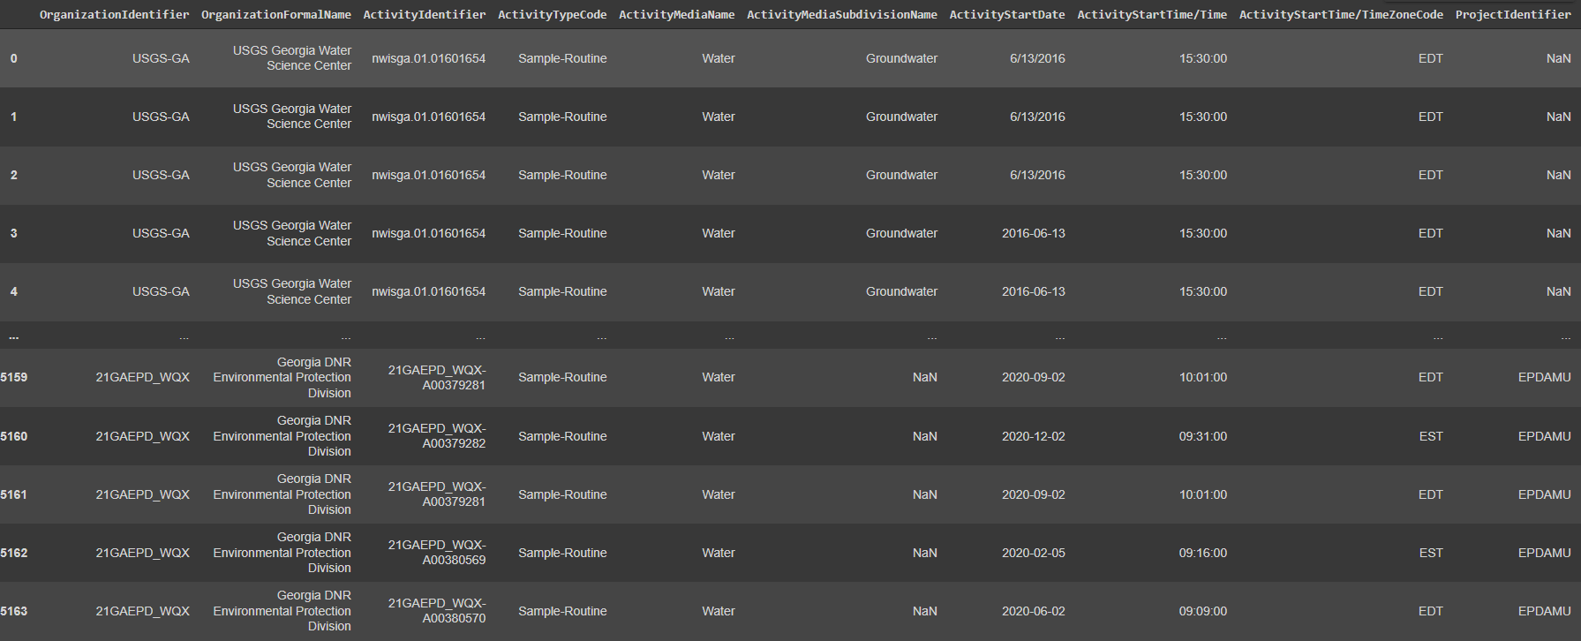

Slide 10
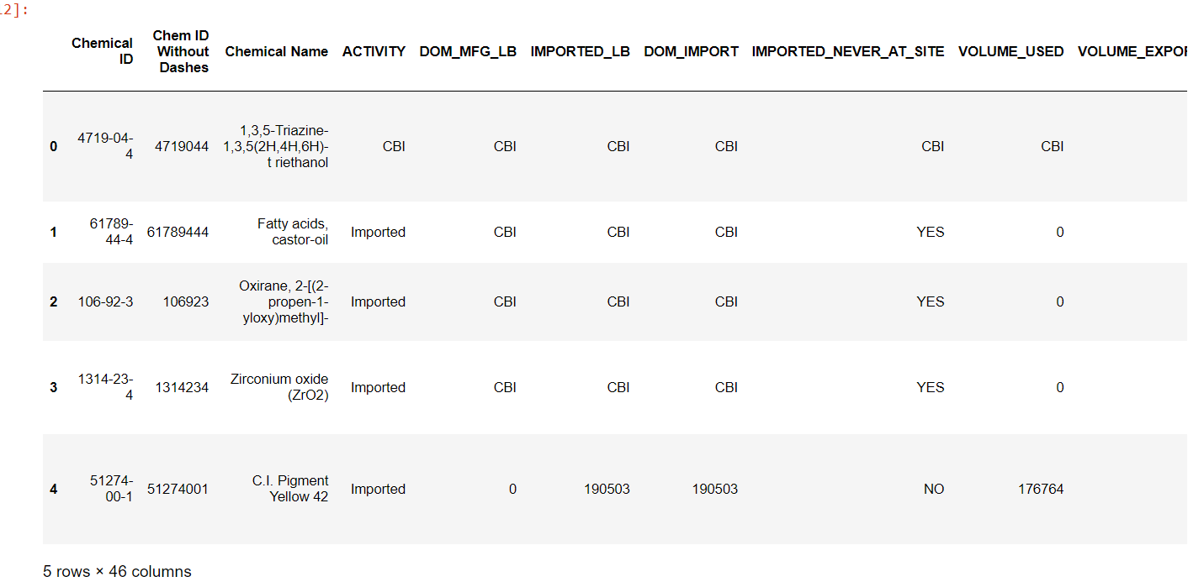

Slide 11
